Slide 1

Blood Line
Department of Computer Science (Non AICTE)
RCC Institute of Information Technology
Canal South Road, Beliaghata, Kolkata-700015
Under Supervision of Mrs. Sudipta Dey, Dept. of CS, RCCIIT
Presented by –
JEET PAL (university roll no – 37701222032)
SUJAL PURBEY (university roll no – 37701222004)
BIJOY GHOSH (university roll no – 37701222008)
ANKITA MODAK (university roll no – 37701222005)

Slide 2
Introduction
Blood Line is an innovative web application created to bridge the gap between blood donors and those in urgent need of blood. In many emergency situations, the delay in locating suitable donors or accessing the required blood type can mean the difference between life and death. Blood Line is designed to address this critical challenge by providing an efficient, user-friendly platform that ensures a smooth and reliable connection between blood donors and requesters.
Blood Line also tackles common challenges faced in the blood donation ecosystem, such as verifying the eligibility of donors, ensuring the availability of specific blood types, and maintaining an organized record of blood requests and donations. By bringing all these features into a single platform, Blood Line empowers communities to respond swiftly to emergencies, promote voluntary blood donations, and create a culture of helping others in need.

Slide 3
Problem Analysis
Blood donation systems in many regions face significant challenges that hinder their effectiveness. Below are some key issues commonly observed in existing blood donation systems:
Lack of Centralized Platforms : Many systems operate in isolation, with no unified platform to connect donors, requesters, and blood banks. This fragmentation makes it difficult for individuals in need of blood to locate suitable donors or check the availability of resources in nearby blood banks.
Delayed Communication : In emergencies, time is of the essence. Traditional methods of finding donors— such as contacting local hospitals, spreading word-of-mouth messages, or relying on outdated databases—are often time-consuming, leading to critical delays in fulfilling blood requests.
Limited Coordination with Local Blood Banks : Existing systems often fail to integrate with blood banks, leading to a lack of visibility into their current stock levels or requirements. This lack of coordination can result in duplicated efforts or wasted resources.

Slide 4
How Blood Line Solves These Issues
To address these challenges, Blood Line offers innovative solutions that focus on streamlining processes, improving communication, and leveraging technology to bridge gaps in the system. Key features include:
Digital Platform for Donor and Requester Registrations : Blood Line provides a centralized web-based platform where donors and requesters can easily register and manage their profiles. Donors can specify their availability, location, and blood type, while requesters can post urgent blood requirements.
Location-Based Matching System : Blood Line uses geolocation technology to match requesters with donors in their vicinity.
Verified Interactions Through Email Notifications : The platform ensures secure and verified communication by sending email notifications to both donors and requesters.

Slide 5
Application Architecture
Administrator
Blood Bank
Data base
Donors
Acceptors

Slide 6
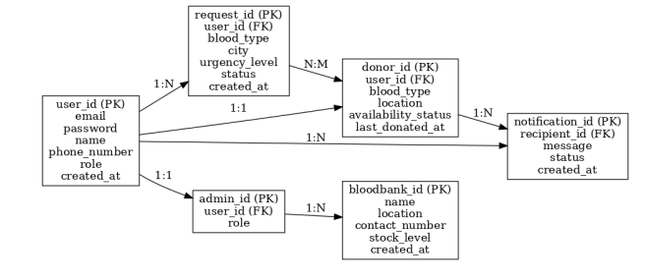
E R Diagram of BLOODLINE

Slide 7
Functional Requirments
Hardware Requirments :-
Processor: Intel core i3 or above for a stable experience and fast retrieval of data.
Hard Disk: 4GB and above
RAM: 256 GB or more, recommended 2 GB for fast reading and writing capabilities which will result in better performance time.
Software Requirments :-
▪ Vite React: For fast development and modular code structure.
▪ Tailwind CSS: For responsive and consistent UI design.
▪ Axios: For seamless API integration.
▪ Node.js: For scalable and asynchronous server-side scripting.
▪ Express.js: For managing routes and APIs.
MySQL: For robust database management.

Slide 8
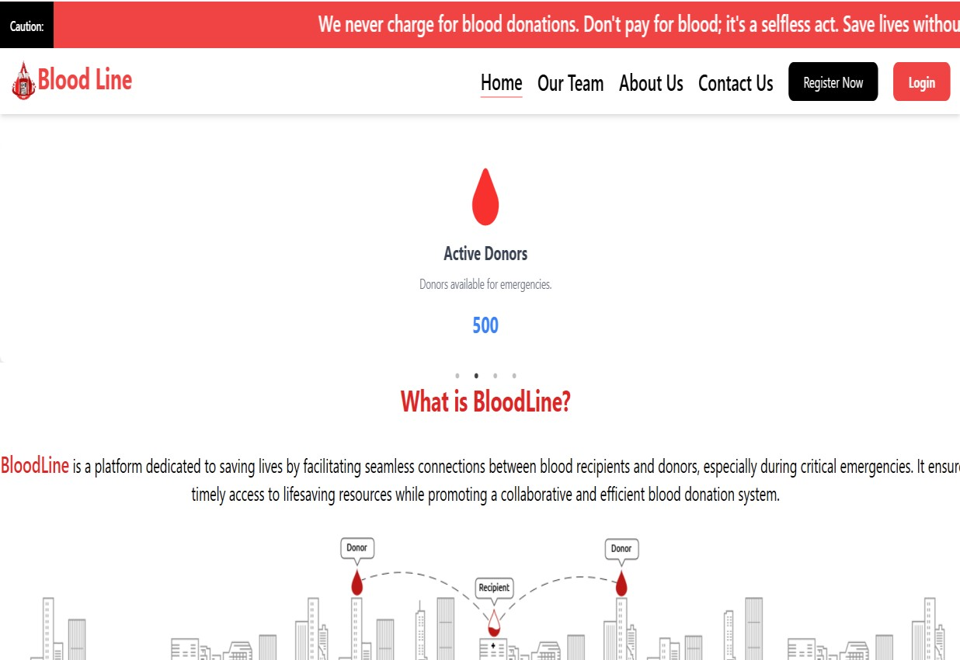
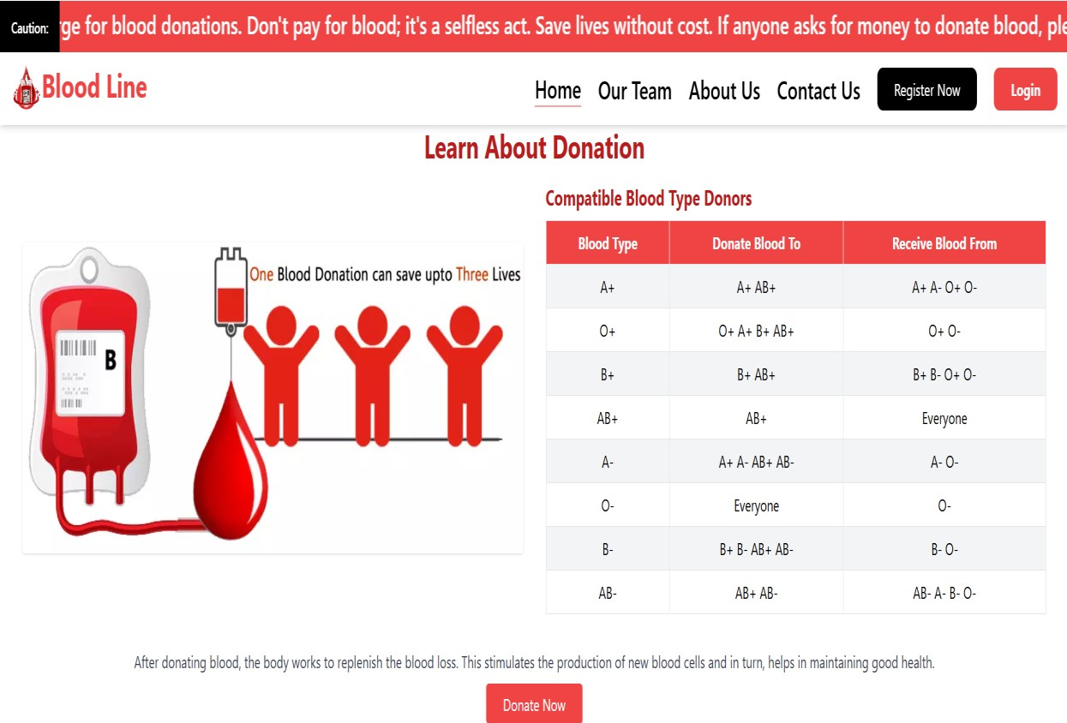
Output Screenshots

Slide 9
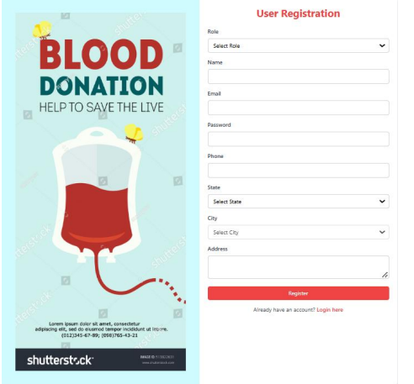
Output Screenshots

Slide 10
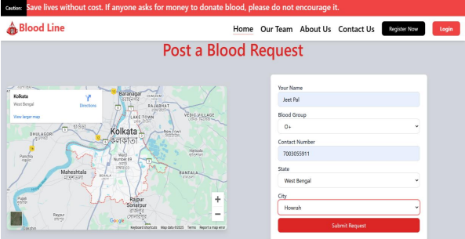
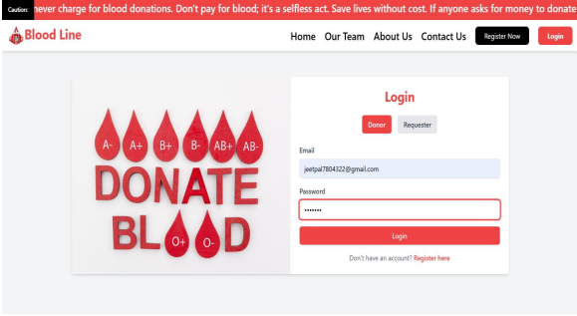
Output Screenshots

Slide 11
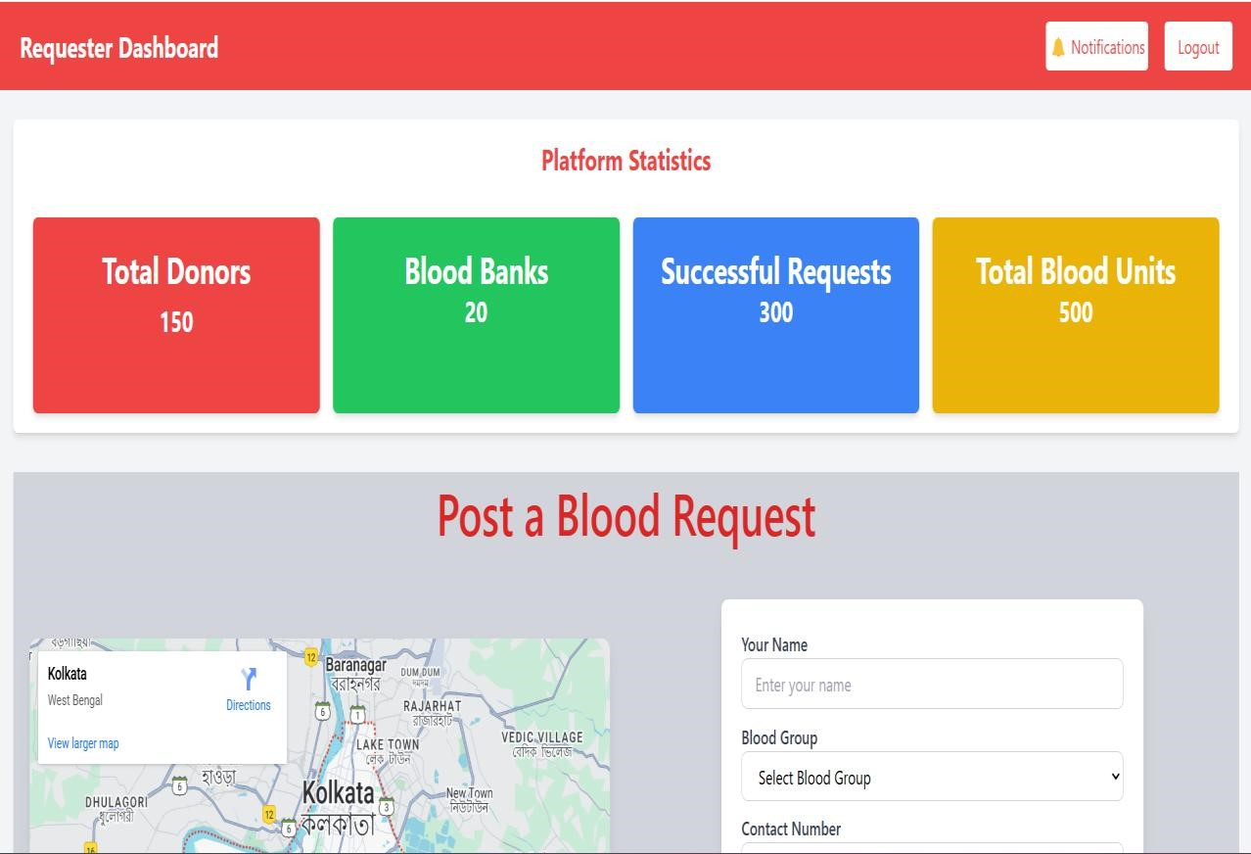
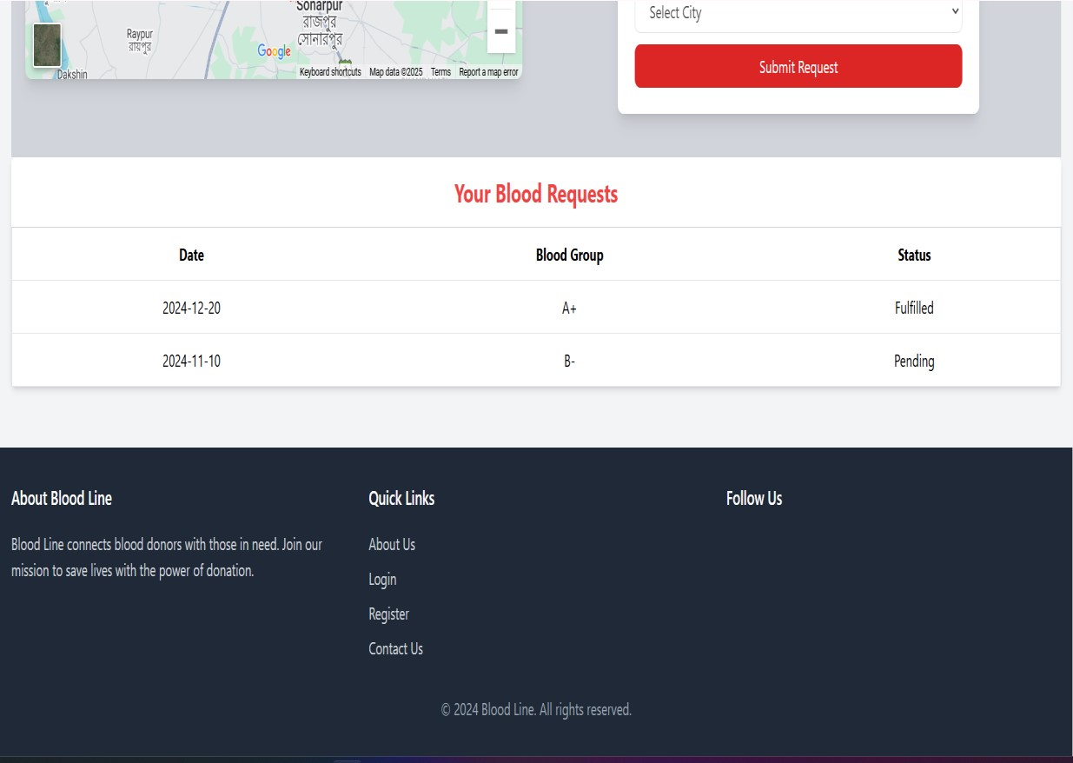
Output Screenshots

Slide 12
Conclusion
Blood Line successfully bridges the gap between blood donors and requesters by leveraging a streamlined, technology-driven approach. The platform efficiently connects users through its intuitive interface, real-time notifications, and robust database management. By facilitating swift and reliable communication between donors, requesters, and blood banks, Blood Line enhances the blood donation process, making it more efficient and impactful.

Slide 13
FUTURE WORK
Enhancing the Chatbot: Incorporating advanced AI capabilities to provide 24/7 support for user queries and guidance.
Mobile Platform Integration: Expanding the system to include iOS and Android apps for better accessibility and convenience.
Real-Time Communication: Adding features for instant messaging or calls between donors and requesters to improve coordination.

Slide 14
Reference
Catassi, C.A., and E.L. Peterson. “The Blood Inventory Control System – Helping Blood Bank
Management through computerized Inventory Control*.” Transfusion 7.1 (1967):
https://www.thebloodcenter.org
Ekanayaka, E. M. S. S.,& Wimaladharma, C. (2015). Blood bank management system.
Technical Session – Computer Science and Technology & Industrial Information

Slide 15
Thank You

